Slide 1
Traits anatomiques caractérisation

Slide 2
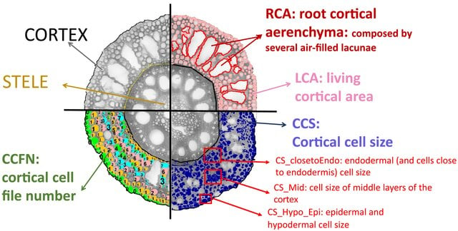
https://www.researchgate.net/publication/334526261_Root_cortical_anatomy_is_associated_with_differential_pathogenic_and_symbiotic_fungal_colonization_in_maize/figures?lo=1

Slide 3
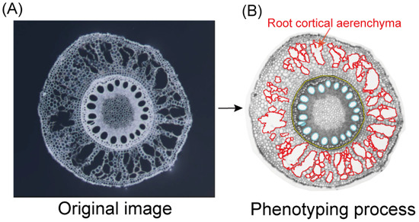
https://www.mdpi.com/2223-7747/15/1/20

Slide 4
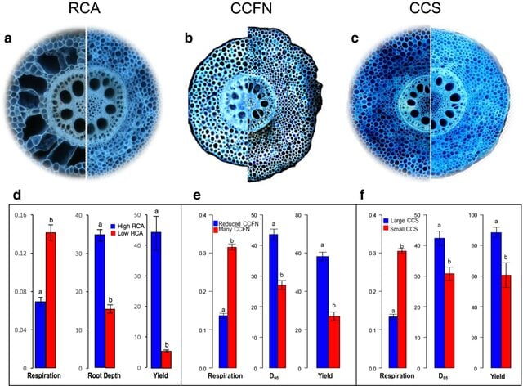
Figure
Caption
Phenotypic variation in maize for root cortical aerenchyma (RCA, a), cortical cell file number (CCFN, b) and cortical cell size (CCS, c). (d) Under water stress, genotypes with greater RCA have less respiration (nmol CO2 s–1 cm–1), deeper rooting (a, cm roots at 40–50 cm soil depth; b, c, D95, which is the depth in cm attained by the 95th percentile of roots), and greater yield (g per plant), as did genotypes with reduced CCFN (e) and greater CCS (f). Data shown are means ± SE (n = 3 or 4). Means with different letters are significantly different (P ≤ 0.05). Redrawn from Lynch (2018)
https://www.researchgate.net/publication/353069360_Root_anatomy_and_soil_resource_capture/figures

Slide 5
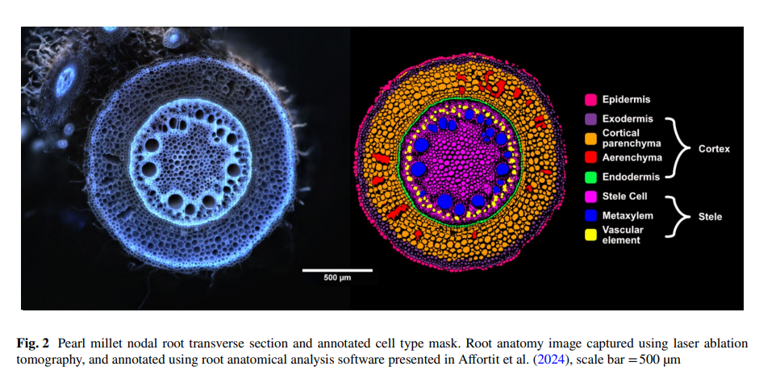
https://link.springer.com/article/10.1007/s11104-025-07498-0

Slide 6
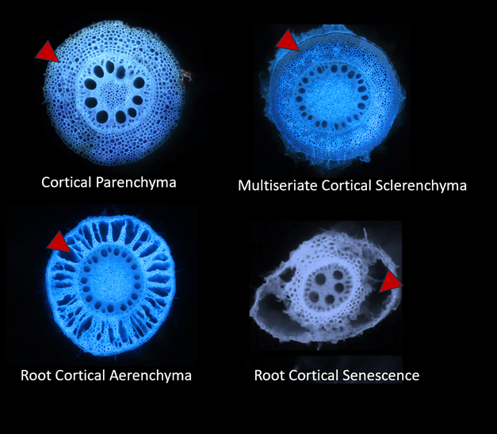
https://plantlifebelowground.wordpress.com/2025/07/30/the-dynamic-world-of-the-root-cortex/

Slide 7
ImageMaster 5.0 software (PhotonTechnology, 2004) was used to capture and save images.Images were analyzed in MatLab 7.6 2008a (MathWorks,2008) using the program RootScan, which was created for thispurpose (Burton et al., 2012).
https://www.researchgate.net/profile/Amy-Burton-9/publication/274435054_Phenotypic_Diversity_of_Root_Anatomical_and_Architectural_Traits_in_Zea_Species/links/654b8882ce88b87031d6a8bd/Phenotypic-Diversity-of-Root-Anatomical-and-Architectural-Traits-in-Zea-Species.pdf

Slide 8
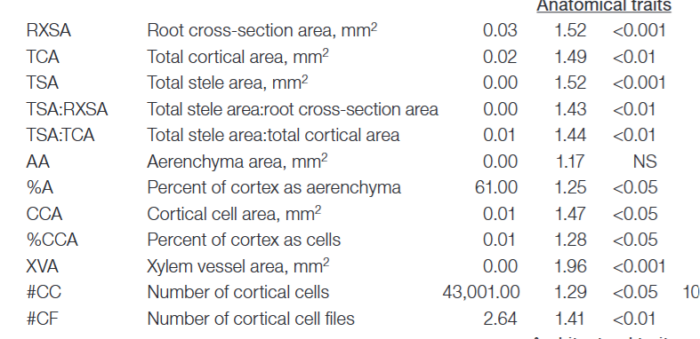
Traits anatomiques mesurés ou calculés
https://www.researchgate.net/profile/Amy-Burton-9/publication/274435054_Phenotypic_Diversity_of_Root_Anatomical_and_Architectural_Traits_in_Zea_Species/links/654b8882ce88b87031d6a8bd/Phenotypic-Diversity-of-Root-Anatomical-and-Architectural-Traits-in-Zea-Species.pdf

Slide 9
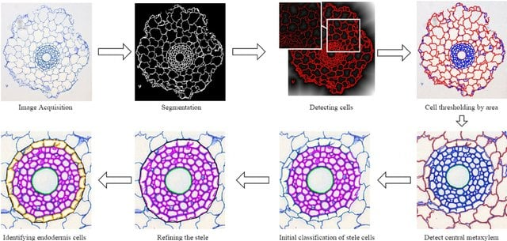
Fig 2. Flowchart outlining the steps of the algorithm. First we acquire the images using a Leica AS LMD laser dissection microscope with a DFC 480 camera and then segment them using a local thresholding technique. Cells are detected using a distance transform of the segmented image and are then initially classified by their area. A number of subsequent steps then correctly classify cells into the four main regions; cortex, stele, endodermis and central metaxylem. doi:10.1371/journal.pone.0137655.g002
https://www.researchgate.net/publication/282128391_RootAnalyzer_A_Cross-Section_Image_Analysis_Tool_for_Automated_Characterization_of_Root_Cells_and_Tissues/figures?lo=1

